Slide 1
Abstract Factory Pattern
Intent
Motivation
Applicability
Structure
Consequences

Slide 2
Intent
Centralize operations on an object structure so that they can vary independently but still behave polymorphically
Motivation
Often adding new operations and distributing operations can become hard to understand, maintain and change. Visitor pattern allows newer operations to be added separately independent of the nodes on which they operate.

Slide 3
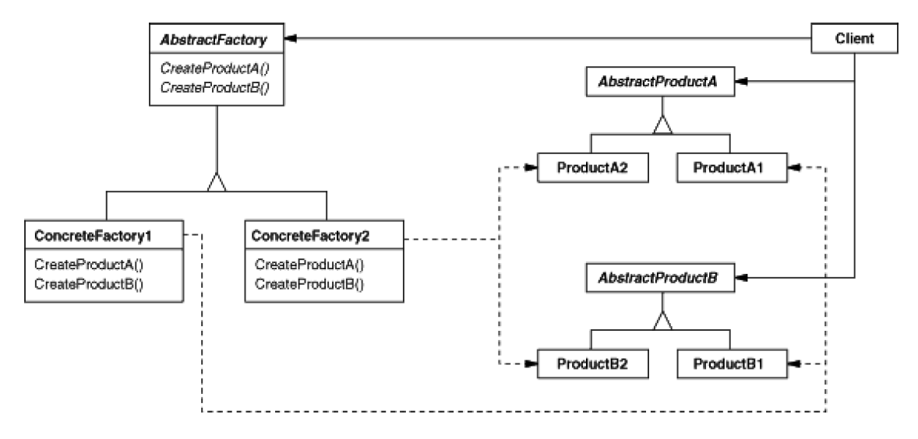
Applicability
When classes define many unrelated operations
Class relationships of objects in the structure rarely change, but the operations on them change often
Algorithms keeps state that is updated during traversal
Structure

Slide 4
Consequences
Consistency: Components are treated the same irrespective of the composition
Flexibility: Visitor algorithms and object structure are independent
Extension: Adding new concrete element subclasses is hard
Dependency: Circular dependency between visitor and element interfaces
Implementation
Double dispatch
General interface to elements of object structure

Slide 5
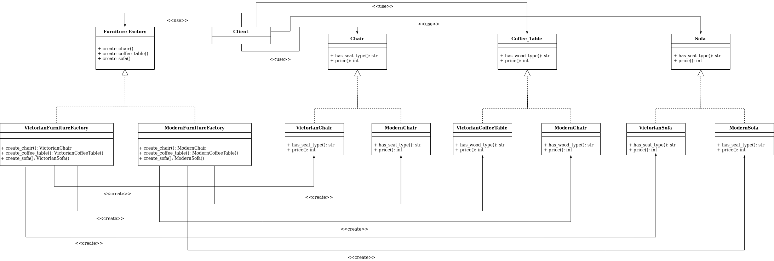
Current Example

